Slide 1
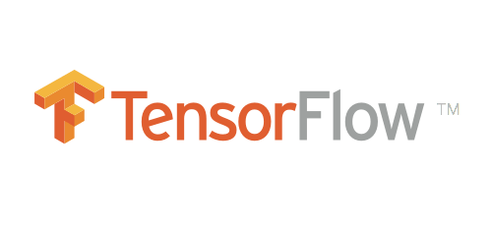

Swift For TensorFlow
Machine Learning for swift.
+
= 🤯
Meir Rosendorff

Slide 2
Tensorflow what?
Tensorflow is a powerful open source machine learning framework built mainly for use in python.
It allows easy abstraction to build and deploy ML models.
Recently google developers have started porting it to swift.
Currently it only works on mac apps.

Slide 3
What’s wrong with python?
The Tensorflow team decided to change from python as they felt it was limiting what they could provide.
Particularly Swift can improve:
  Performance
  Deployability
  Static code analysis
  Good Debugger
  Memory Safety

Slide 4
So what did they do?
Python Interoperability
  We can now use python libraries natively in our swift code.
Automatic Differentiation
  Differentiate functions.
Graph Program Extraction
  Performance enhancements

Slide 5

Lets try out some python interoperability.

Slide 6
Concerns...
Python libraries and functions are only imported at runtime.
  This defeats the purpose of swift’s strict type safety.
  We can now crash a few hours into a run because a library doesn’t exist or the wrong parameters are being passed to a function.
This is no small issue
  It may be cool but would you be comfortable deploying this code?

Slide 7
What I did?
We decided to investigate whether this framework is possible to use to train a model.
Whether its viable for future use.
Whether this model could be converted to a coreML model and used in an app.

Slide 8

Original plan
We found a dataset of breathing sounds.
We wanted to see if we could diagnose a condition based on the sound.

Slide 9
Original Plan Cont.
Great we took the sounds, extracted features and trained a great model….
But then I got stuck, I can’t put this in an app.
Theres no way to extract good audio features in swift without implementing your own feature extraction in c++. (someone hadn’t already done it on stack overflow, I checked! )

Slide 10
Take 2
Our second idea was to train a model that recognizes Sign Language letters.
I felt this was a bit more viable as a coreML model already has the ability to accept an image as input.

Slide 11
This kind of worked
We where able to fulfil the goals we set out.
  We built and trained a model entirely in swift.
  Converted this into a coreMl model.
  Used the coreML Model in an iOS App
The model wasn’t terribly accurate but I think thats down to the dataset and my model design (I couldn’t really optimize hyperparameters so I guessed until it worked)

Slide 12
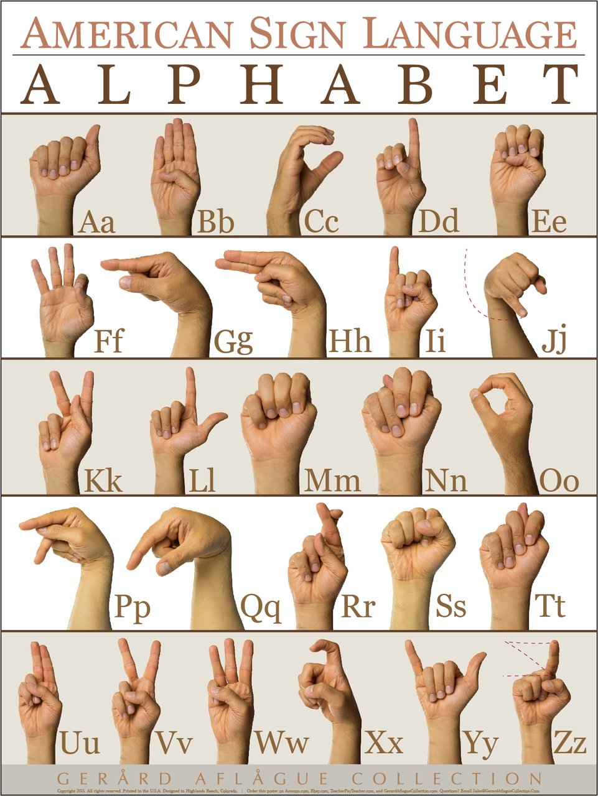

Slide 13

Is it viable?
It may be possible but is it viable to use?

Slide 14

Lets try
Lets build a model quickly and see exactly whats involved.

Slide 15
Conclusion
Is it possible?
  With much pain, tears and heartache...Yes.
Is it viable?
  Not yet, not anytime soon.
  TensorFlow needs to be improved.
  Swift needs some native data manipulation libraries.

Slide 16
Discussion
What do you think of the framework?
What do you think could have been done differently?

